Slide 1
Module : 2/2
Module: 2 /2
Class:VII
Subject: English(Honeycomb)
Chapter: 3 Gopal and the Hilsa fish
Name of the Teacher: Mrs. Eva Guria
Name of the School: AECS, Narwapahar

Slide 2
Recaptulation:
Who was Gopal?
Why was the king angry?
What was the challenge given to Gopal?
What preparation did Gopal make to complete his challenge?

Slide 3
Gopal’s wife Reaction Gopal’s wife got worried to see him dressed in disgraceful manner.she thought that her husband has gone out of mind. She tried to stop him but Gopal went out of the house.

Slide 4
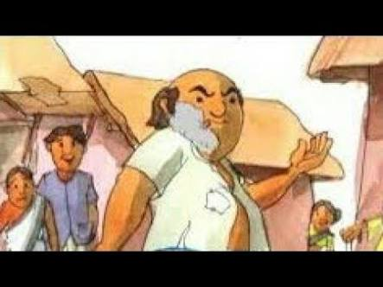
Gopal Goes to Market .
When Gopal reached to market. Every body looked at Gopal because of his peculiar appearance. They found him comical.

Slide 5
Gopal buys the Hilsa Gopal brought the Hilsa fish and started walking towards the palace. Everybody was surprised to see him but no one could dare to ask him about anything. They were talking about the weird looking man but not about Hilsa which he was carrying.

Slide 6
. Gopal goes towards the palace On the way to palace, people looked at him. Some believed that he was a mad man yet some thought that he was a mystic. Soon he reached to the palace gate.

Slide 7
Guards Stop Gopal Gopal reached to the palace gate but he was stopped by the guards.He requested them to allow him to enter the gate but they refused.

Slide 8
Gopal begins to dance and sing Being stopped at the gate, Gopal started dancing and singing loudly.He did so to catch the attention of the king.

Slide 9
The King allows Gopal to enter the palace After hearing the commotion happening outside, the king asked the guards to send the man inside the palace. Gopal was brought before the king. All the courtiers including the king were shocked to see Gopal in that get up and nobody noticed the Hilsa fish which Gopal brought to the palace.

Slide 10
Gopal wins the challenge The king finally remembered the challenge he had thrown to Gopal. He was very happy that Gopal had achieved the impossible task.Gopal won the heart of the king and proved that he was a brilliant courtier.

